Slide 1
Spatial Data Management
12

Slide 2
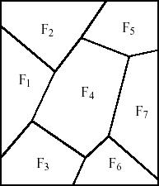
Relational Representation of Spatial Data
Example: Representation of geometric objects (here: fields of land) in normalized relations. Redundancy free representation requires distribution of information over 3 tables!
Fields
FID | BID
F₁ | B₁
F₁ | B₂
F₁ | B₃
F₁ | B₄
F₄ | B₂
F₄ | B₅
F₄ | B₆
F₄ | B₇
F₄ | B₈
F₄ | B₉
F₇ | B₁₀
F₇ | B₁₁
F₇ | B₁₂
... | ...
Borders
BID | PID₁ | PID₂
B₁ | P₁ | P₂
B₂ | P₂ | P₃
B₃ | P₃ | P₄
B₄ | P₄ | P₁
B₅ | P₂ | P₅
B₆ | P₅ | P₆
B₇ | P₆ | P₇
B₈ | P₇ | P₈
B₉ | P₈ | P₃
B₁₀ | P₆ | P₉
B₁₁ | P₉ | P₁₀
B₁₂ | P₁₀ | P₇
Points
PID | XCoord | YCoord
P₁ | X_{P1} | Y_{P1}
P₂ | X_{P2} | Y_{P2}
P₃ | X_{P3} | Y_{P3}
P₄ | X_{P4} | Y_{P4}
P₅ | X_{P5} | Y_{P5}
P₆ | X_{P6} | Y_{P6}
P₇ | X_{P7} | Y_{P7}
P₈ | X_{P8} | Y_{P8}
P₉ | X_{P9} | Y_{P9}
P₁₀ | X_{P10} | Y_{P10}
P₃
B₂
P₂

Slide 3
Relational Representation of Spatial Data
For (spatial) queries involving fields it is necessary to reconstruct the spatial information from the different tables
E.g.: if we want to determine if a given point P is inside field F₂, we have to find all corner-points of parcel F₂ first
SELECT Points.PID, XCoord, YCoord FROM Fields, Border, Points WHERE FID = ‘F2’ AND Fields.BID = Borders.BID AND (Borders.PID1 = Points.PID OR Borders.PID2 = Points.PID)
Even this simple query requires expensive joins of 3 tables
Querying the geometry is not directly supported (P in F₂?)

Slide 4
Extension of Relational Model for Spatial Data
Integration of spatial data types and operations into the core of a DBMS (→ object-oriented and object-relational databases)
Data types such as Point, Line, Polygon
Operations such as ObjectIntersect, RangeQuery, etc.
Advantages:
Natural extension of the relational model and query languages
Facilitates design and querying of spatial databases
Spatial data types and operations can be supported by spatial index structures and efficient algorithms, implemented in the core of a DBMS
All major database vendors today implement support for spatial data and operations in their database systems via object-relational extensions

Slide 5
Extension of Relational Model for Spatial Data
Example:
ForestZones(Zone:Polygon,ForestOfficial:String,Area:Cardinal)
The province decides that a reforestation is necessary in an area described by a polygon S. Find all forest officials affected by this decision.
SELECT ForestOfficial FROM ForestZones WHERE ObjectIntersects (S,Zone)
ForestZones
Zone | ForestOfficial | Area (m²)
R₁ | Stevens | 3900
R₂ | Behrens | 4250
R₃ | Lee | 6700
R₄ | Goebel | 5400
R₅ | Jones | 1900
R₆ | Kent | 4600
R₂
R₄
R₆
R₁
R₃
R₅

Slide 6
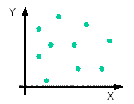
Data Types for Spatial Objects
Spatial objects are described by
Spatial Extent
• location and/or boundary with respect to a reference point in a coordinate system, which is at least 2-dim.
• Basic object types: Point, Lines, Polygon
Other Non-Spatial Attributes
• Thematic attributes such as height, area, name, etc.
2-dim. points 2-dim. lines 2-dim. polygons
Crop
Water
Forest

Slide 7
Spatial Query Processing
DBMS has to support two types of operations
Operations to retrieve certain subsets of spatial object from the database
“Spatial Queries/Selections”, e.g., window query, point query, etc.
Operations that perform basic geometric computations and tests
E.g., point in polygon test, intersection of two polygons etc.
Spatial selections, e.g. in geographic information systems, are often supported by an interactive graphical user interface

Slide 8
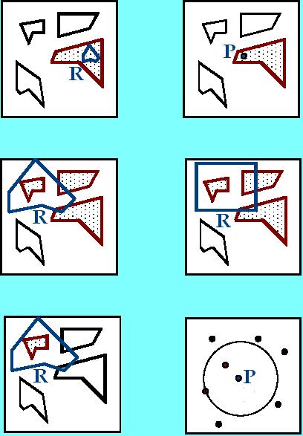
Basic Spatial Queries
Containment Query: Given a spatial object R, find all objects that completely contain R. If R is a point: Point Query
Region Query: Given a region R (polygon or circle), find all spatial objects that intersect with R. If R is a rectangle: Window Query
Enclosure Query: Given a polygon region R, find all objects that are completely contained in R
K-Nearest Neighbor Query: Given an object P, find the k objects that are closest to P (typically for points)
Containment Query
Point Query
Region Query
Window Query
Enclosure Query
2-nn Query

Slide 9
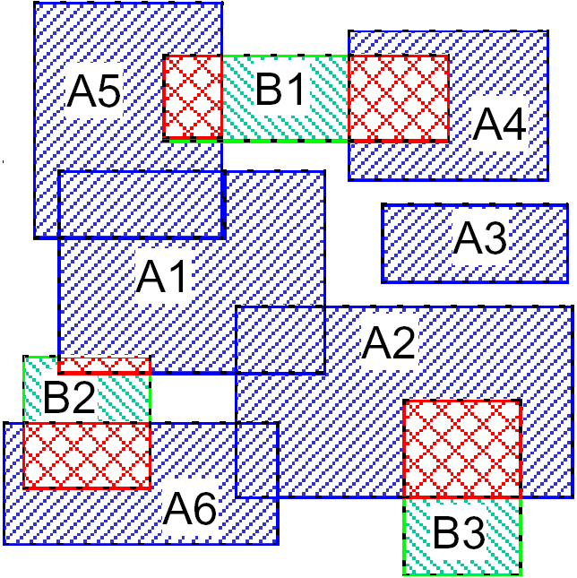
Basic Spatial Queries - Spatial Join
Given two sets of spatial objects (typically minimum bounding rectangles)
S₁ = {R₁, R₂, …, R_{m}} and S₂ = {R’₁, R’₂, …, R’_{n}}
Spatial Join: Compute all pairs of objects (R, R’) such that
R ∈ S₁, R’ ∈ S₂ and R intersects R’ (R ∩ R’ ≠ ∅)
Spatial predicates other than intersection are also possible, e.g. all pairs of objects that are within a certain distance from each other
{A₁, A₂,.., A₆} ⊗ {B₁,…,B₃}
Answer set
(A₅, B₁)
(A₄, B₁)
(A₁, B₂)
(A₆, B₂)
(A₂, B₃)
Spatial Join

Slide 10
Index Support for Spatial Queries
Conventional index structures such as B-trees are not designed to support spatial queries
Group objects only along one dimension
Do not preserve spatial proximity
E.g. nearest neighbor query:
Nearest neighbor of Q is typically not the nearest neighbor in any single dimension
y
nn(Q)
C
Q
A and B closer in the X dimension;
C and D closer in the Y dimension.
D
A
B
x

Slide 11

Index Support for Spatial Queries (cont)
Spatial index structures try to preserve spatial proximity
Group objects that are close to each other on the same data page
Problem: the number of bytes to store extended spatial objects (lines, polygons) varies
Solution:
Store Approximations of spatial objects in the index structure, typically axis-parallel minimum bounding rectangles (MBR)
Exact object representation (ER) stored separately; pointers to ER in the index
Spatial Index
…(MBR, ,…) (MBR, ,…)…
(ER)

Slide 12
Query Processing Using Approximations
Two-step procedure:
1. Filter Step:
– Use the index to find all approximations that satisfy the query
– Some objects already satisfy the query based on the approximation, others have to be checked in the refinement step → Candidate Set
2. Refinement Step:
– Load the exact object representations for candidates left after the filter step and test whether they satisfies the query

Slide 13
Query Processing Using Approximations
Query window
a and b are certain answers
f, d, g are certainly not answers
c and e are candidates
c is a false hit
a
b
c
e
f
d
g
false
hits
Final result
candidates
refinement
Query
filter
not an answer

Slide 14
Embedding of the 2-dim. space into a 1-dim space
Basic Idea:
The data space is partitioned into rectangular cells.
Use a space filling curve to assign cell numbers to the cells (define a linear order on the cells)
The curve should preserve spatial proximity as good as possible
Cell numbers should be easy to compute
Objects are approximated by cells.
Store the cell numbers for objects in a conventional index structure with respect to the linear order
21
23
29
31
53
55
61
63
20
22
28
30
52
54
60
62
17
19
25
27
49
51
57
59
16
18
24
26
48
50
56
58
5
7
13
15
37
39
45
47
4
6
12
14
36
38
44
46
1
3
9
11
33
35
41
43
0
2
8
10
32
34
40
42

Slide 15
Space Filling Curves
Lexicographic order
56
57
58
59
60
61
62
63
48
49
50
51
52
53
54
55
40
41
42
43
44
45
46
47
32
33
34
35
36
37
38
39
24
25
26
27
28
29
30
31
16
17
18
19
20
21
22
23
8
9
10
11
12
13
14
15
0
1
2
3
4
5
6
7

Slide 16
Space Filling Curves (cont)
Hilbert Curve
63
62
49
48
47
44
43
42
60
61
50
51
46
45
40
41
59
56
55
52
33
34
39
38
58
57
54
53
32
35
36
37
5
6
9
10
31
28
27
26
4
7
8
11
30
29
24
25
3
2
13
12
17
18
23
22
0
1
14
15
16
19
20
21

Slide 17
Space Filling Curves
Z-Order
Z-Order preserves spatial proximity relatively good
Z-Order is easy to compute
21
23
29
31
53
55
61
63
20
22
28
30
52
54
60
62
17
19
25
27
49
51
57
59
16
18
24
26
48
50
56
58
5
7
13
15
37
39
45
47
4
6
12
14
36
38
44
46
1
3
9
11
33
35
41
43
0
2
8
10
32
34
40
42

Slide 18
Z-Order – Z-Values
Coding of Cells
Partition the data space recursively into two halves
Alternate X and Y dimension
Left/bottom → 0
Right/top → 1
Z-Value: (c, l)
c = decimal value of the bit string
l = level (number of bits)
- if all cells are on the same level, then l can be omitted
0
1
0
1
1
1
1
0
0
0
0
1
10 → 2
0111 → 7
010000 → 16

Slide 19
Z-Order - Representation of Spatial Objects
21
23
29
31
53
55
61
63
For Points
Use a fixed a resolution of the space in both dimensions, i.e., each cell has the same size
Each point is then approximated by one cell
For extended spatial object
minimum enclosing cell
Problems with cells that intersect the first partitions already
improvement: use several cells
Better approximation of the objects
Redundant storage
Redundant retrieval in spatial queries
20
22
28
30
52
54
60
62
17
19
25
27
49
51
57
59
16
18
24
26
48
50
56
58
5
7
13
15
37
39
45
47
4
6
12
14
36
38
44
46
1
3
9
11
33
35
41
43
0
2
8
10
32
34
40
42
C₂
C
R
C₁
R
C₃
C₄
Coding of R by one cell
Coding of R by several cells
R
Query Window
Query returns the same answer several times

Slide 20
Z-Order – Mapping to a B⁺-Tree
Linear order for Z-values to store them in a B+-tree:
Let (c₁, l₁) and (c₂, l₂) be two Z-Values and let l = min{l₁, l₂}.
The order relation ≤_{Z} (that defines a linear order on Z-values) is then defined by:
(c₁, l₁) ≤_{Z} (c₂, l₂) iff (c₁ div 2^{(l1-l)}) ≤ (c₂ div 2 ^{(l2-l)})
Examples:
(1,2) ≤_{Z} (3,2),
(3,4) ≤_{Z} (3,2),
(1,2) ≤_{Z} (10,4)

Slide 21
Mapping to a B⁺-Tree - Example
Root
( 6 , 3 )
( 7 , 4 )
( 6 , 3 )
( 0 , 2 )
( 2 , 3 )
( 6 , 4 )
( 7 , 4 )
( 4 , 3 )
( 20,5 )
( 21,5 )
( 11 ,4 )
( 6 , 3 )
( 7 , 3 )
( 0 , 2 ) ≤ ( 7 , 4 ) ≤ ( 7 , 4 ) ≤ ( 6 , 3 )
( 2 , 3 ) ≤ ( 7 , 4 ) ≤ ( 4 , 3 ) ≤ ( 6 , 3 )
( 6 , 4 ) ≤ ( 7 , 4 ) ≤ ( 20 , 5 ) ≤ ( 6 , 3 )
Exact representations stored in a different location

Slide 22
Mapping to a B⁺-Tree - Window Query
Window Query → Range Query in the B⁺-tree
find all entries (Z-Values) in the range [l, u] where
l = smallest Z-Value of the window (bottom left corner)
u = largest Z-Value of the window (top right corner)
l and u are computed with respect to the maximum resolution/length of the Z-values in the tree (here: 6)
( 6 , 3 )
( 7 , 4 )
( 6 , 3 )
( 0 , 2 )
( 2 , 3 )
( 6 , 4 )
( 7 , 4 )
( 4 , 3 )
( 20,5 )
( 21,5 )
( 11 ,4 )
( 6 , 3 )
( 7 , 3 )
(10,6) ≤ (2,3) Result (0,2)
Window: Min = (0,6), Max = (10,6)

Slide 23
R-Trees
The R-tree is a tree-structured index that remains balanced on inserts and deletes.
Each key stored in a leaf entry is intuitively a box, or collection of intervals, with one interval per dimension.
Example in 2-D:
Root of
R Tree
Y
Leaf
level
X

Slide 24
R-Tree Properties
Leaf entry = < n-dimensional box, rid >
key value being a box.
Box is the tightest bounding box for a data object.
Non-leaf entry = < n-dim box, ptr to child node >
Box covers all boxes in child node (in fact, subtree).
All leaves at same distance from root.
Nodes must be kept at least 50% full (except root).
Can choose a parameter m that is <= 50%, and ensure that every node is at least m% full.

Slide 25
Example of an R-Tree
Leaf entry
R₁
Index entry
R₄
R₁₁
Spatial object
approximated by
bounding box R₈
R₃
R₅
R₁₃
R₉
R₈
R₁₄
R₁₀
R₁₂
R₇
R₁₈
R₆
R₁₇
R₁₆
R₁₉
R₁₅
R₂

Slide 26
Example R-Tree (cont.)
R₁
R₂
R₃
R₄
R₅
R₆
R₇
R₈
R₉
R₁₀
R₁₁
R₁₂
R₁₃
R₁₄
R₁₅
R₁₆
R₁₇
R₁₈
R₁₉

Slide 27
Search for Objects Overlapping Box Q
Start at root.
1. If current node is non-leaf, for each
entry <E, ptr>, if box E overlaps Q,
search subtree identified by ptr.
2. If current node is leaf, for each entry
<E, rid>, if E overlaps Q, rid identifies
an object that might overlap Q.
Note: May have to search several subtrees at each node!
(In contrast, a B-tree equality search goes to just one leaf.)

Slide 28
Improving Search Using Constraints
It is convenient to store boxes in the R-tree as approximations of arbitrary regions, because boxes can be represented compactly.
But why not use convex polygons to approximate query regions more accurately?
Will reduce overlap with nodes in tree, and reduce the number of nodes fetched by avoiding some branches altogether.
Cost of overlap test is higher than bounding box intersection, but it is a main-memory cost, and can actually be done quite efficiently. Generally a win.

Slide 29
Insert Entry <B, ptr>
Start at root and go down to “best-fit” leaf L.
Go to child whose box needs least enlargement to cover B; resolve ties by going to smallest area child.
If best-fit leaf L has space, insert entry and stop. Otherwise, split L into L₁ and L₂.
Adjust entry for L in its parent so that the box now covers (only) L₁.
Add an entry (in the parent node of L) for L₂. (This could cause the parent node to recursively split.)

Slide 30
Splitting a Node During Insertion
The entries in node L plus the newly inserted entry must be distributed between L₁ and L₂.
Goal is to reduce likelihood of both L₁ and L₂ being searched on subsequent queries.
Idea: Redistribute so as to minimize area of L₁ plus area of L₂.
GOOD SPLIT!
BAD!

Slide 31
R-Tree Variants
The R* tree uses the concept of forced reinserts to reduce overlap in tree nodes. When a node overflows, instead of splitting:
Remove some (say, 30% of the) entries and reinsert them into the tree.
Could result in all reinserted entries fitting on some existing pages, avoiding a split.
R* trees also use a different heuristic, minimizing box perimeters rather than box areas during insertion.
Another variant, the R+ tree, avoids overlap by inserting an object into multiple leaves if necessary.
Searches now take a single path to a leaf, at cost of redundancy.

Slide 32
GiST
The Generalized Search Tree (GiST) abstracts the “tree” nature of a class of indexes including B+ trees and R-tree variants.
Striking similarities in insert/delete/search and even concurrency control algorithms make it possible to provide “templates” for these algorithms that can be customized to obtain the many different tree index structures.
B+ trees are so important (and simple enough to allow further specialization) that they are implemented specially in all DBMSs.
GiST provides an alternative for implementing other tree indexes in an ORDBS.

Slide 33
Indexing High-Dimensional Data
Typically, high-dimensional datasets are collections of points, not regions.
E.g., Feature vectors in multimedia applications.
Very sparse
Nearest neighbor queries are common.
R-tree becomes worse than sequential scan for most datasets with more than a dozen dimensions.
As dimensionality increases contrast (ratio of dist. between nearest and farthest points) usually decreases; “nearest neighbor” is not meaningful.
In any given data set, advisable to empirically test contrast.

Slide 34
Summary
Spatial data management has many applications, including GIS, CAD/CAM, multimedia indexing.
Point and region data
Overlap/containment and nearest-neighbor queries
Many approaches to indexing spatial data
R-tree approach is widely used in GIS systems
Other approaches include Grid Files, Quad trees, and techniques based on “space-filling” curves.
For high-dimensional datasets, unless data has good “contrast”, nearest-neighbor may not be well-separated

Slide 35
Comments on R-Trees
Deletion consists of searching for the entry to be deleted, removing it, and if the node becomes under-full, deleting the node and then re-inserting the remaining entries.
Overall, works quite well for 2 and 3 D datasets. Several variants (notably, R+ and R* trees) have been proposed; widely used.
Can improve search performance by using a convex polygon to approximate query shape (instead of a bounding box) and testing for polygon-box intersection.

